Slide 1
Onion Agro Supply chain analysis and optimization
Project batch
Kanishkan B (17BME031) Hari Prasad R (17BME052) Hrishikesh N M (17BME117)
Guide
Dr. M. Balaji
Associate Professor
Department of Mechanical Engineering
PROJECT PRESENTATION FOR END SEMESTER EXAMINATION

Slide 2
Problem Definition
India is the world’s third-largest producer of food grains, the second-largest producer of fruits and vegetables and the largest producer of milk; it also has the largest number of livestock. It is estimated that global food production must be increased by 60–110% to feed 9–10 billion of the population by 2050.
To satisfy this huge demand and to proactively react to evolving changes a well optimized and well connected data driven supply chain is needed for the agricultural industry.

Slide 3
Objective
To optimize the supply chain network in the agriculture industry more specifically for Perishable products like onion and this is done through:
Time series forecast of commodity prices
Market fluctuation analysis
Exploring correlation between commodity prices and various variables (like GDP, fuel price, etc.)
Performance measurement using Supply chain measurement indexes.
Risk evaluation

Slide 4
Abstract
Agriculture is the primary source of livelihood for about 58% of India’s population. India is the third-largest producer of vegetables and the second-largest producer of onion. Indian onions are famous for their pungency and are available round the year. Indian onions have two crop cycles, first harvesting starts in November to January, and the second harvesting from January to May. Having said the significance of onion cultivation in India, this project mainly deals with the cost forecasting and the supply chain optimization of the Indian onion agro supply chain. The main purpose of this project is to develop a mathematical model to forecast and analyze the cost of onion in the Indian market starting from 2004 to 2020. We specifically took the onion price data of Chennai Market as the acquired data was relevant and accurate. The monthly wholesale prices and arrivals data for the study collected from the National Horticultural Research and Development Foundation. The three main machine learning models used in the project are the Mean Model, Linear Model, and the Random walk Model. We have also visualized the forecasted data through a line graph comparing the factors: cost and date. The accuracy of proportion among the forecasted and actual price value of the onion was found in between 95.4 to 99.5 percent. We found that the linear model was more accurate comparing the other three mathematical models.

Slide 5
Literature Survey
S.No. | Journal details | Interpretations
1 | PRIYANKA KUMBHAR, NAMRATA GAIDOLE and DR. HEMANT SHARMA, “Price forecasting and Seasonality of Soybean in Amravati District of Maharashtra India”, Current Agriculture Research Journal, 2019, pg. 417-423 | Crop yield prediction in agriculture is significant because it supports better crop management and plan marketing activities ML algorithms in providing real-time analytic insights for pro-active data-driven decision-making
2 | Xuan Pham, Martin Stack, “How data analytics is transforming agriculture”, Business Horizons, 2018, 125-133. | The rise of data analytics in farming is commonly referred to as precision agriculture (PA). Geographic Positioning Systems (GPS), Sensors, Geomapping, Assisted automatic guidance steering systems, Electronic communications, Variable rate technology (VRT).

Slide 6
Literature Survey
S.No. | Journal details | Interpretations
3 | Bongsug (Kevin) Chaea , David Olsonb and Chwen Sheua, “The impact of supply chain analytics on operational performance: a resource-based view” International Journal of Production Research, 2013. | Three sets of resources: Data management resources (DMR), IT Enabled planning resources and Performance management resources (PMR). DMR should be considered a key building block in supply chain planning.
4 | George Baryannisa, Samir Dani, Grigoris Antoniou, “Predicting supply chain risks using machine learning: The trade-off between performance and interpretability”, Future Generation Computer Systems, 2019, 993-1004. | Machine learning models can be leveraged to accurately predict supply chain risks. Decision tree models can reveal correlations that influence Supply Chain Risk Management (SCRM) decision-making.

Slide 7
Literature Survey
S.No. | Journal details | Interpretations
5 | Rohit Sharma, Anjali Shishodia,Sachin Kamble, “Agriculture supply chain risks and COVID-19: mitigation strategies and implications for the practitioners”, International Journal of Logistics Research and Applications, 2020. | Identified and assessed the ASC risks caused by disruptions like COVID 19. strategies such as adoption of industry 4.0 technologies, supply chain collaboration and shared responsibility is identified for sustainable future.
6 | D. J. Bartholomew, “Time Series Analysis Forecasting and Control”, Journal of the Operational Research Society, 2017, 199-201. | A stochastic model for such a process explains in probabilistic terms how a series arises. Moving average model is used.

Slide 8
Literature Survey
S.No. | Journal details | Interpretations
7 | Real Carbonneau, Kevin Laframboise, Rustam Vahidov, “Application of machine learning techniques for supply chain demand forecasting”, European Journal of Operational Research, 2008, 1140-1154. | investigated the applicability of advanced machine learning techniques, including neural networks recurrent neural networks support vector machines to forecasting distorted demand at the end of a supply chain.
8 | Tan Xuewen Du Zhixiong , "Postmodern Agriculture: From an Approach of Sustainable Food Supply Chain [J]" , Journal of China Agricultural University (Social Sciences Edition) 1, 2010 | The main stream modern agriculture made a pathway where the future of post modern agriculture can be transformed by the principles of eco agriculture. Sustainablility of ecological agriculturing practises and typical alternate agriculture can be achieved using supply chain analytics.

Slide 9
Literature Survey
S.No. | Journal details | Interpretations
9 | Rohit Sharma, Sachin S Kamble, Angappa Gunasekaran, Vikas Kumar, Anil Kumar, " A systematic literature review on machine learning applications for sustainable agriculture supply chain performance",Computers & Operations Research, 104926, 2020 | Disruptive information helps to find out the solutions for the problems like productivity and yield improvement, water conservation, ensuring soil and plant health, and enhance environmental stewardship. Data analytics hold the key to ensure future food security, food safety, and ecological sustainability
10 | Liu Qiao, Shen Xin, Sun Xu , "Research on risk evaluation of agriculture product supply chain [J]",Journal of Agricultural Mechanization Research 9, 2011 | Supply chain risk such as technical risk, information risk, quality and coordination of organisational risk and security risk can be evaluated with the help of AHP and fuzzy comprehensive evaluation methods. Agricultural supply chain has a structural complexity and market uncertainty,market power imbalance and vulnerability and so on.

Slide 10
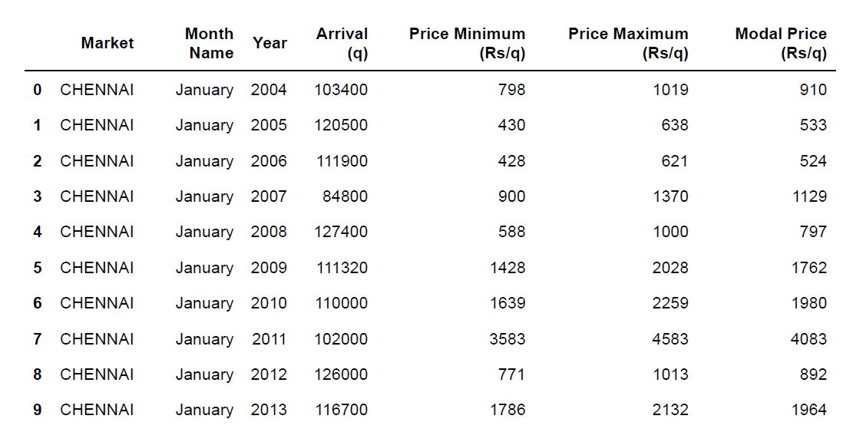
Data Collection
The website of National Horticultural Research & Development Foundation and maintains a database on Market Arrivals and Price, Area and Production and Export Data for three commodities - Garlic, Onion and Potatoes. It has data from 2004 onwards and has only got one form to fill to get the data in a tabular form.

Slide 11
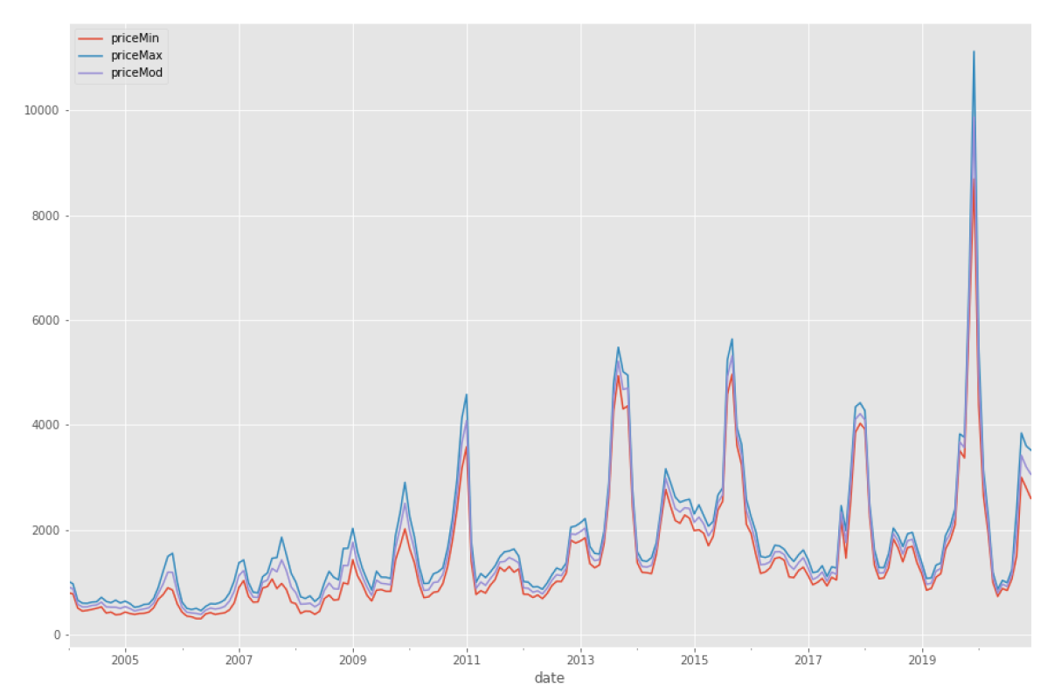
Exploratory Data Analysis
DATE vs PRICE

Slide 12
TIME SERIES FORECASTING
We built three basic time-series forecasting model to get a forecast for Onion prices.
Mean Constant Model
Linear Trend Model
Random Walk Model

Slide 13
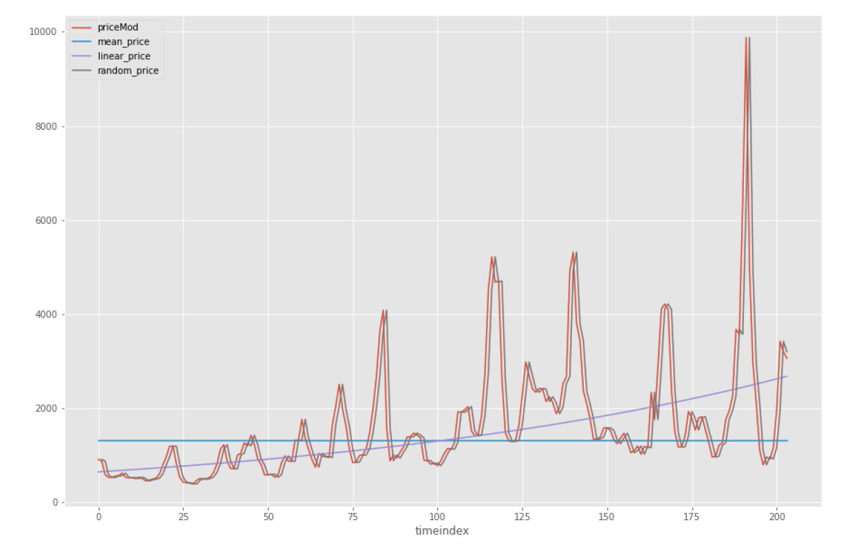
MACHINE LEARNING MODEL
DAYS vs PRICE

Slide 14
FORECASTED OUTPUT FOR DEC 2020
S.No. | Model | Actual Price (Rs/q) | Predicted Price (Rs/q)
1 | Mean Model | 3060 | 1312.94
2 | Linear Model | 3060 | 3074.81
3 | Random walk Model | 3060 | 3200

Slide 15
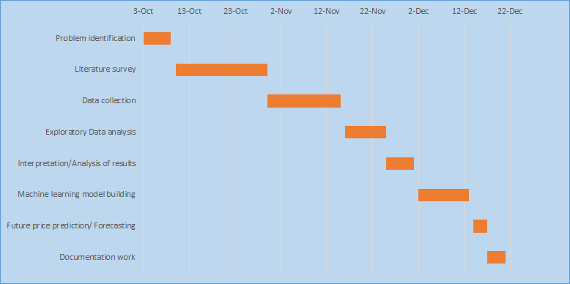
Gantt Chart

Slide 16
PLAN FOR PHASE 2
Develop a supply chain model with data collected and analyzed in phase 1.
Optimize the supply chain by finding correlations between cost and climatic conditions
Identify the reason behind the constant fluctuation in the Onion price
Performance measurement using Supply chain measurement indexes.
Strategies to improve and make the current supply chain efficient.

